Slide 1

While You Wait
Workshop
Supporting your child whilst awaiting assessment with Kirklees Keep in Mind
(Primary)

Slide 2
Presentation created by
Clare Smith – Assistant Educational Mental Health Practitioner
Introductions
What is Kirklees Keep in Mind?
Provide 1:1 interventions for children and young people to support their mental health
Advice and signposting to other services
Offer group work and workshops to CYP and families

Slide 3
Key Information
As this is a public workshop, we are unable to offer 1-1 support for individual cases or discuss concerns regarding risk as this would need to be done at the time of assessment, however if you feel you need urgent support there are services who can offer this.
A document with supporting information is available on our website for you to download with links to websites, apps, services and providers who can provide support with risk and neurodevelopment support.
The skills we will be sharing in this session can be adapted to suit neurodivergent children and young people’s unique needs using your knowledge of how to support your child.
We are unable to advise on waiting times, you will be contacted as soon as a practitioner becomes available.
Please be aware the chat is not monitored during this session.
Please maintain confidentiality during and after the session.
Please completed the feedback at the end of the session.

Slide 4





This lightbulb indicates a vital skill which will support you in managing your emotions.
This care symbol indicates where there may be a need for self care.
This reflection symbol indicates where you might need to reflect honestly about how you are currently managing situations.
The practices I will be sharing today are evidence based and proven to help.
The more you put these practices into action, the more they will be embedded to support you when you need them to.

Slide 5
This lightbulb indicates a vital skill which will support your child in managing their emotions.
This care symbol indicates where there may be a need for self care, not only for your child or young person but also in looking after yourself as well as your child.
This reflection symbol indicates where you might need to reflect honestly about how you are currently managing situations.
The practices I will be sharing today are evidence based and proven to help.
The more you put these practices into action, the more they will be embedded to support your child when they need them to.

Slide 6






Common Mental Health Difficulties
What is anxiety/low mood?
An introduction to mental health
Health Difficulties
Common Mental
Anxiety
Health Difficulties
Low Mood
Common Mental
Notes:
Reflect as we go through this presentation, are there things we talk about that you may have picked up as unhealthy habits or behaviours?
Not as to punish but to understand the roots of why these feelings and emotions seem to take control, will help us regain the strength to regain that control and manage these better so they don’t impact with our daily functioning

Slide 7
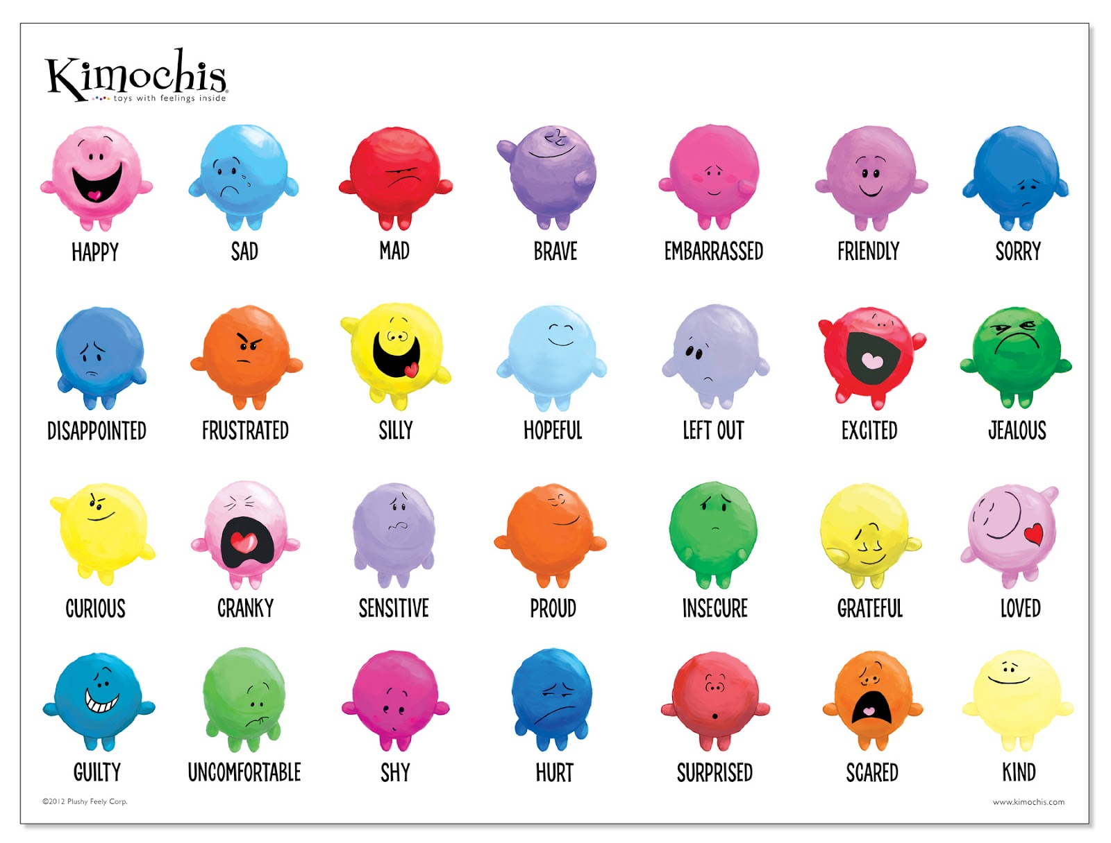
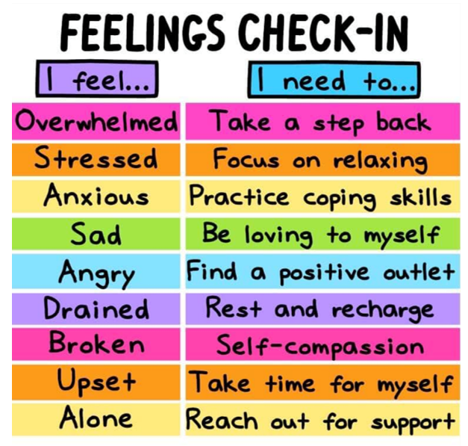
Different emotions we may feel
Naming feelings can help children feel calmer.
This Photo by Unknown Author is licensed under CC BY-NC
Notes:
Sometimes we can name them sometimes we can’t, we just feel…something but unsure what. Even if you can’t name the emotion, recognise it.

Slide 8

Back up team!
Work out with your child, who their 5 trusted people are and who they would be happy to speak to about their worries (home, school, other places, friends).
Also consider who you go to for support, maybe do this as an activity with your child.
Knowing who to ask for help and opening up to other people always helps lessen worries and others can help with solutions for problem solving worries.
Friend’s parents / Preople in the community
Teacher/pastoral worker
Grandparents
Older siblings/friends
Parents/Carers
Me

Slide 9
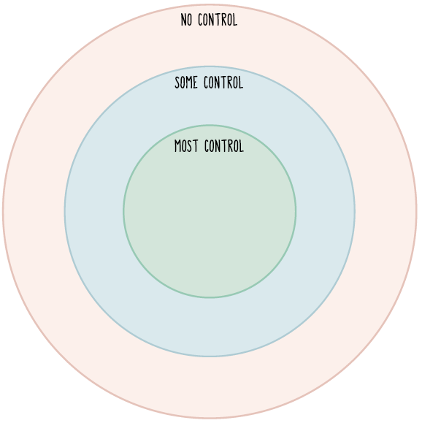
Back up team!
- Managing what I can and cannot control
Teacher/pastoral worker
Friend’s parents / Preople in the community
Grandparents
What I can control
My words
My actions/reactions
How hard I try
How I treat others
Taking care of myself
Asking for help
The friends I choose
What I choose to eat
Older siblings/friends
Parents/Carers
Me
What I can not control
Past mistakes/bad decisions
The law
Rules or routines
The weather
Being sick
Other people – their actions, words, reactions, how they treat people
Notes:
Circle of control – what situations trigger thoughts, feelings and behaviours
Learn to recognise who you can ask for support in coping with different situations
Is this something you can manage right now or is this something you need to ask for help with?

Slide 10
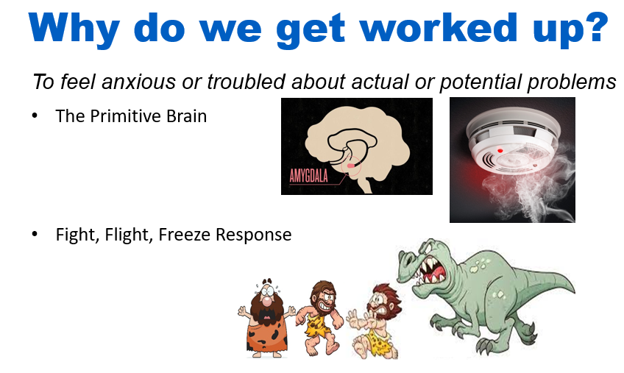
Why do we get worked up?
The Fight, Flight, Freeze response

Slide 11
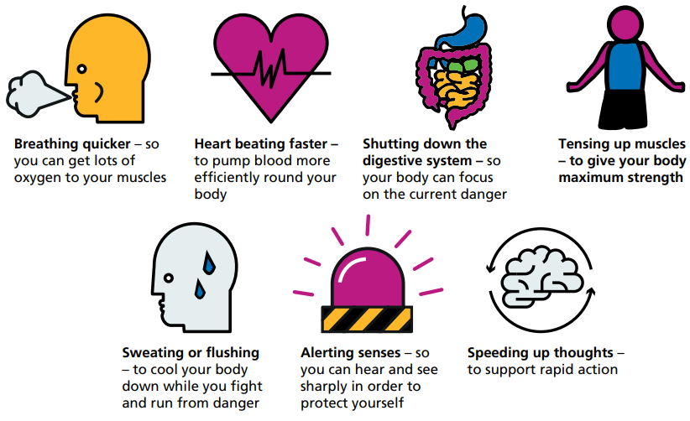
Where do you feel physical symptoms of anxiety?
Notes:
Think about their physical self, where do they feel signs of anxiety/low mood, try to pinpoint it to the very first sign, this is where we need to be recognising when we need to be utilising coping strategies.

Slide 12
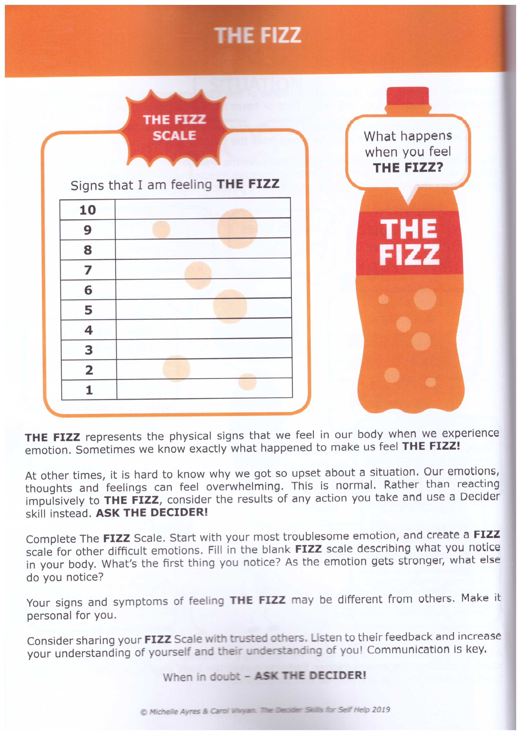
Skill - The FIZZ
The FIZZ represents the physical signs in our body when we experience emotion. Sometimes we know why we feel the FIZZ, sometimes we don’t.
Our feelings and emotions can become overwhelming. This is normal!
Through recognizing the FIZZ, you can stop it before it gets to the popping point.
Rather than reacting impulsively, think about responding with a more thought-out action and use strategies to calm the emotion.
Notes:
Link to how a bottle of fizzy pop reacts to being shaken up, use one as a prop.

Slide 13

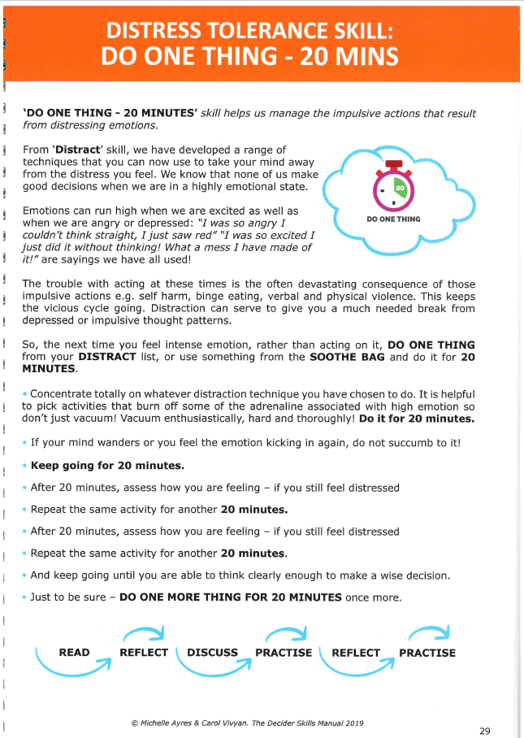
Skill – DO ONE THING
We know the FIZZ only last 20-30 mins and we don’t make good decisions when in a highly emotional state.
Until this passes, we need to distract our mind which we can do by Doing One Thing.
Create a DISTRACT list or box with things in it to regain calm and DO ONE THING from this list or box. These may be things such as colouring, sensory toys, bubbles, a face mask or other forms of self care, things which can distract from heightened emotions such as anger, anxiety etc.
Choose one thing from the distraction list and
keep doing this until the fizz passes.
Set an alarm for 20 minutes, then re-assess your emotions and see if you need to DO ONE MORE THING and repeat.

Slide 14

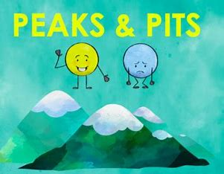
How can you help yourself as well as your child?
Notes:
As parents we often want to fix things for our children but it’s important to understand that sometimes we need recognise when to sit along side them and help manage what arises for them.
It’s crucial to recognise when you need to manage your own distress whilst your child is distressed and implement self care. Use these coping strategies to support yourself as well as your child.
How do you show your child you are managing your emotions? Do you show them when you’re anxious? How do you show them how you cope? Do you share your successes as well as your challenges? They can naturally copy your strategies, whether they are healthy or otherwise.
Telling your child you’ve had a stressful day at work helps them to understand how you manage your emotions. They learn to understand stress is normal and it happens to everyone. It is important to recognise that you are a role model in how you manage your emotions.

Slide 15
Many worries
Feeling tense
Headache
Tummy ache
Not sleeping
Grumpy
Not enjoying things
Being negative about things
Stress Cycle

Slide 16

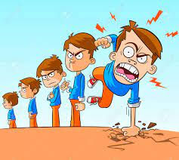


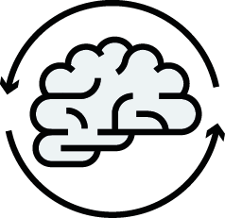

Adolescence (Ages 10-24)
Impulsivity, decision making and abilities
Ability to Manage Emotions during Adolescence
Sleep pattern changes
Relationship Changes and Identity development
Notes:
Serotonin – a chemical in the body that manages moods is at an all time low during the teenage years.
This means it is common for teenagers to feel more stressed and overwhelmed
Teenagers may feel really angry or sad and not really know why
As the emotional brain is more active than the thinking brain, teenager’s emotions can be bigger and more prominent than their decision-making ability, so it is harder to manage emotions!
Teenagers...
May find it hard to control what you say/tone and may interrupt people
May be more impulsive and being more prone to taking risks
May spend money more frivolously
May find you are less good at something you used to be good at doing
May find yourself being clumsier than before
As the brain changes and develops, our preferences and personality changes and develops.
This means that it is likely that friendships may break down, people grow apart at make new friends
As the emotional brain is so much more active than the thinking brain it is common for teenagers to have more arguments with their parents/carers
Teenagers have a natural instinct to develop their independence so they may take more notice of what their peers think than their parents/carers
Again, the activity of the emotional brain increases the drive towards friendships and romantic relationships over things like schoolwork
This may also bring about some confusion around your identity
May experience low self-esteem and compare self to others

Slide 17

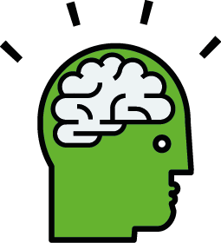
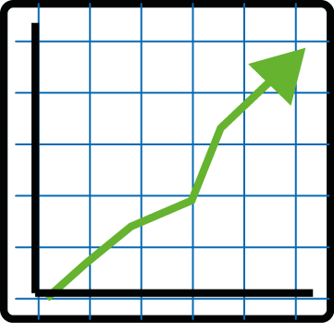

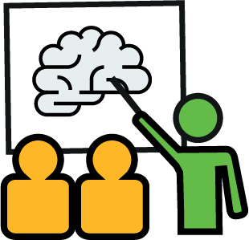

The Impact of sleep on daily functioning and emotional well-being
Concentration and Focus
Memory Consolidation
Academic Performance
Behavioural Implications
Mood Regulation
Stress less and emotional resilience
Notes:
Academic Performance
Quality sleep is essential for optimal cognitive function, including attention, problem-solving, and decision-making abilities in adolescents.
Memory Consolidation
Adequate sleep supports the consolidation of learning and memory, enhancing academic performance and information retention.
Concentration and Focus
Improved sleep quality is associated with better concentration and focus, leading to enhanced learning outcomes.
Stress Less
Quality sleep contributes to stress reduction and emotional resilience, enabling adolescents to better cope with the challenges of school and social interactions.
Mood Regulation
Proper sleep hygiene is linked to improved mood regulation, reducing the risk of mood disorders and emotional disturbances in secondary school children.
Behavioural Implicatios
Inadequate sleep can lead to irritability, impulsive behaviour, and difficulty in managing emotions among adolescents.

Slide 18



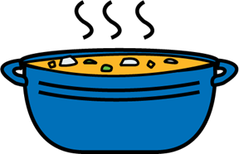

Suggestions for a healthy bedtime routine
Have a bedtime routine such as, brush teeth,
put pyjamas on, read a book, go to
bed at the same time every night.
Try to avoid screen time just before bed!
Wake-up at the same time every morning.
Eat breakfast, lunch and tea - Eating regularly.
Routine is in your control – This is so important to help your child to feel safe and happy

Slide 19
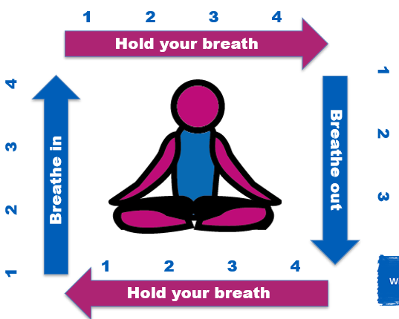

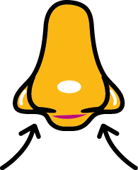
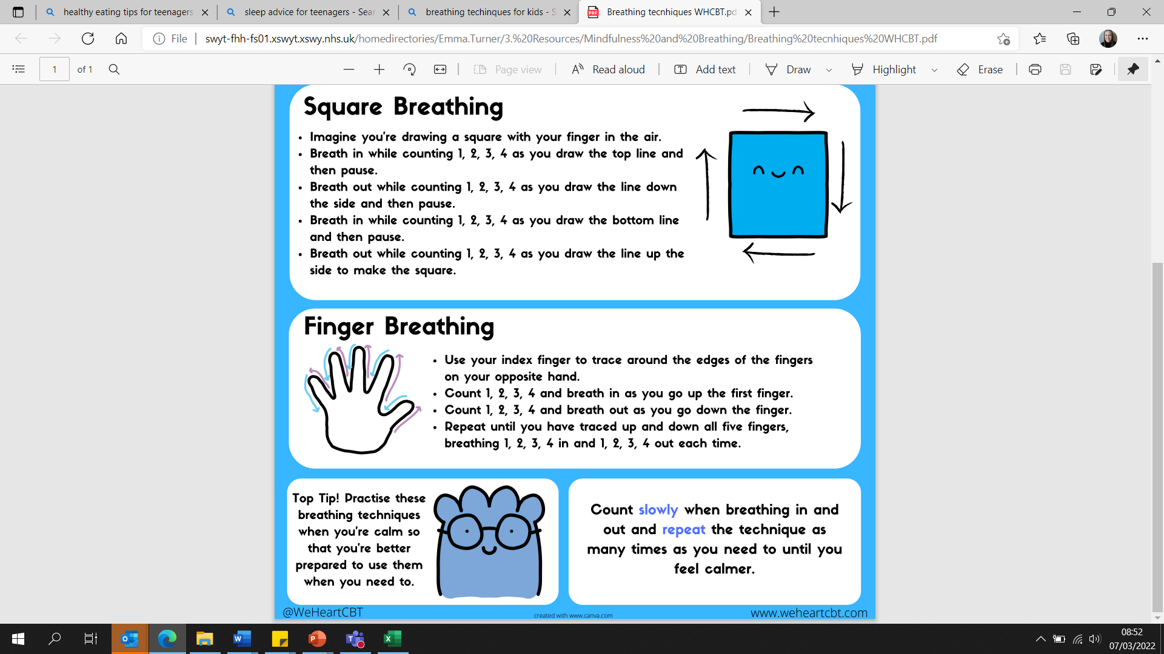







Skill – BREATHING PRACTICES
Square breathing
Either draw a square in the air with your index finger or find a four-sided shape to focus your attention on when taking deep breaths in a square.

Slide 20
Practice Relaxation Skills
Breathing techniques such as finger breathing or square breathing.
Sleep sounds or meditations. Through apps such as calm and Headspace but also available on YouTube and various music outlets such as Apple or Amazon music and Spotify.
Thinking about one positive / funny
memory.
Talking to your child about their worries

Slide 21
So what other skills can help?

Slide 22
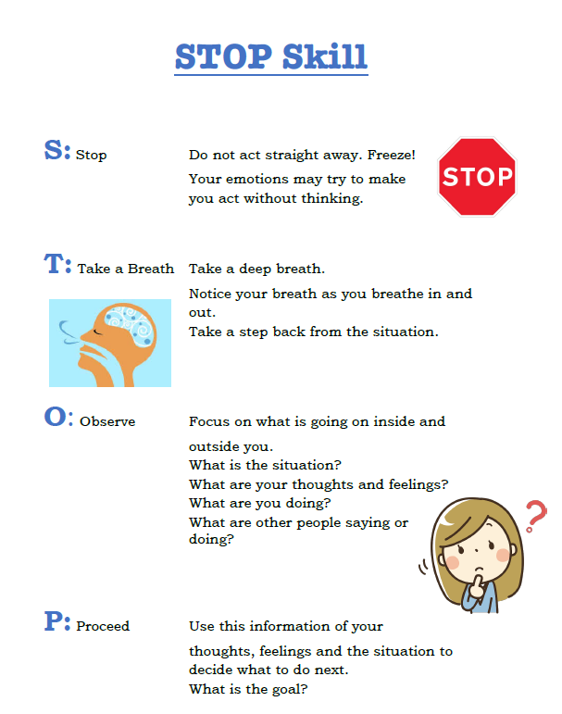
Skill - STOP
This creates a much needed pause to allow us to regulate our nervous system and respond more calmly

Slide 23
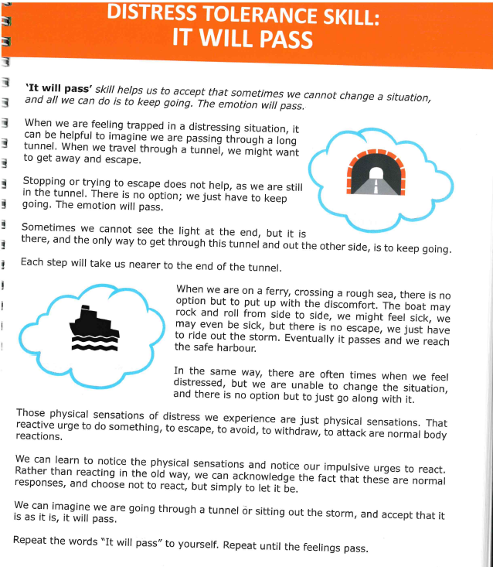
Skill - IT WILL PASS
The amygdala can only fizz for 20-30 minutes maximum.
This FIZZ will pass. In recognizing this we learn to accept that sometimes we can’t change a situation, it may not be fair or nice, but we have to keep going. But we know it will pass!
E.g. Car in a dark tunnel.
Physical sensations of distress we experience are the reactive urges to do something, to escape, avoid, withdraw or attack.
By learning to notice the physical sensations and notice our impulsive urges to react we can acknowledge them and choose to not react and simply let it be.

Slide 24
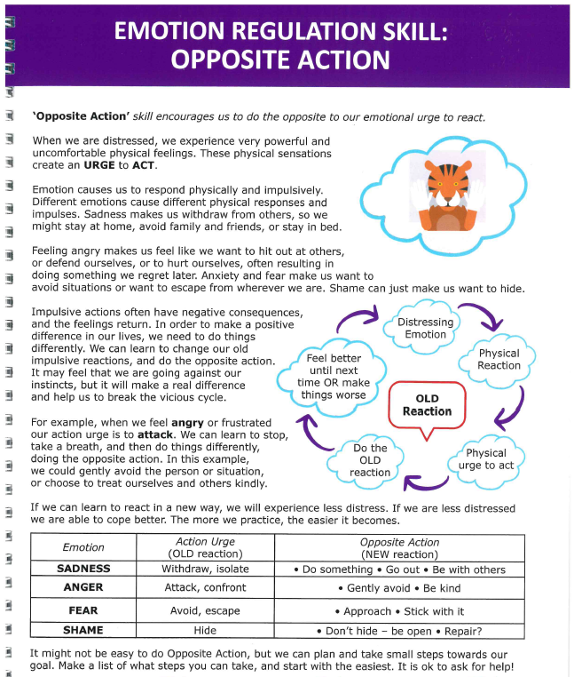
Skill – OPPOSITE ACTION
What do we do when we are
Sad? Angry? Frightened? Shame?
These can be very powerful and uncomfortable physical feelings which create an URGE to ACT impulsively
What if we were to do the opposite action…
When feeling sad, we want to withdraw so instead could STOP, do things with others, do something which I enjoy or practice self care.
When feeling angry, we want to attack and confront the reason for the feelings so instead could STOP, step away, be kind, worry about the other person, avoid the conflict.
When feeling frightened, we want to escape or avoid things, instead we could STOP, do it anyway, keep trying with little steps.
When feeling shame, we want to hide away, instead we could STOP, be open to repair any damage caused, make amends or be open.
By learning a new way to react we experience less distress which helps us to cope with the emotions better.

Slide 25
Skill – RIGHT NOW
RIGHT NOW is a grounding technique which uses 54321 to calm distress.
We can use our five senses to do something RIGHT NOW to help us to improve the moment.
This is also a very useful skill when feeling distracted and needing to refocus our attention.
Could also be done using shapes, colours, football teams or songs by an artist.

Slide 26
The following information can be quite upsetting as we discuss self harm.
As outlined at the beginning of the presentation, please refer to the supporting information document, a direct link has been put in the chat to where you can download this from our website as this contains valuable information to support with risk and self harm. There are many websites, apps, services and providers who can provide support.
We are unable to discuss case by case information prior to assessment.

Slide 27
What is self-harm?
Self-harm is when somebody intentionally damages or injures their body. It's usually a way of coping with or expressing overwhelming emotional distress.
(NHS.uk, 2018)
Common forms of self-harm include..
Cutting
Poisoning
Over-eating or under-eating
Exercising excessively
Biting
Picking or scratching
Burning
(Mind website, 2021)
Inserting objects into the body
Hitting yourself on walls
Substance misuse
Pulling hair
Having unsafe sex
Getting into fights where you know you will get hurt.
Notes:
Why might a young person self-harm?
A way of expressing distress and painful emotions/feelings and communicating these to others
A way of coping with painful and difficult feelings
Relieve tension and frustration
Attempt to feel safe and gain control
Punish self
Anxiety and low-mood
Bullying
Questioning identity, sexuality, gender

Slide 28
Helpful vs unhelpful responses to self harm
Be calm and try not to show shock or distress
Try and be openminded to the reasons why a young person has self-harmed
Take it at their pace - Let them remain in control as much as possible and don’t force them to talk about it and give them the option to talk to you
Be compassionate and understanding
Try not to trivialise the reason for self-harm
Be positive and focus on strengths
It’s useful to see the wounds if the young person is willing and appropriate
Notes:
How can you help?
If you suspect that a young person might be self-harming, please don’t ignore it.
It can be daunting to ask questions around self-harm. Staying calm is the most important thing. This will help you to be more open to listening and asking questions to understand what is going on.
This could look like...
“I’ve noticed that there are some bruises or cuts on your arms. Sometimes people can hurt themselves if they’re struggling. I was wondering if that’s something that you are doing to yourself?”

Slide 29
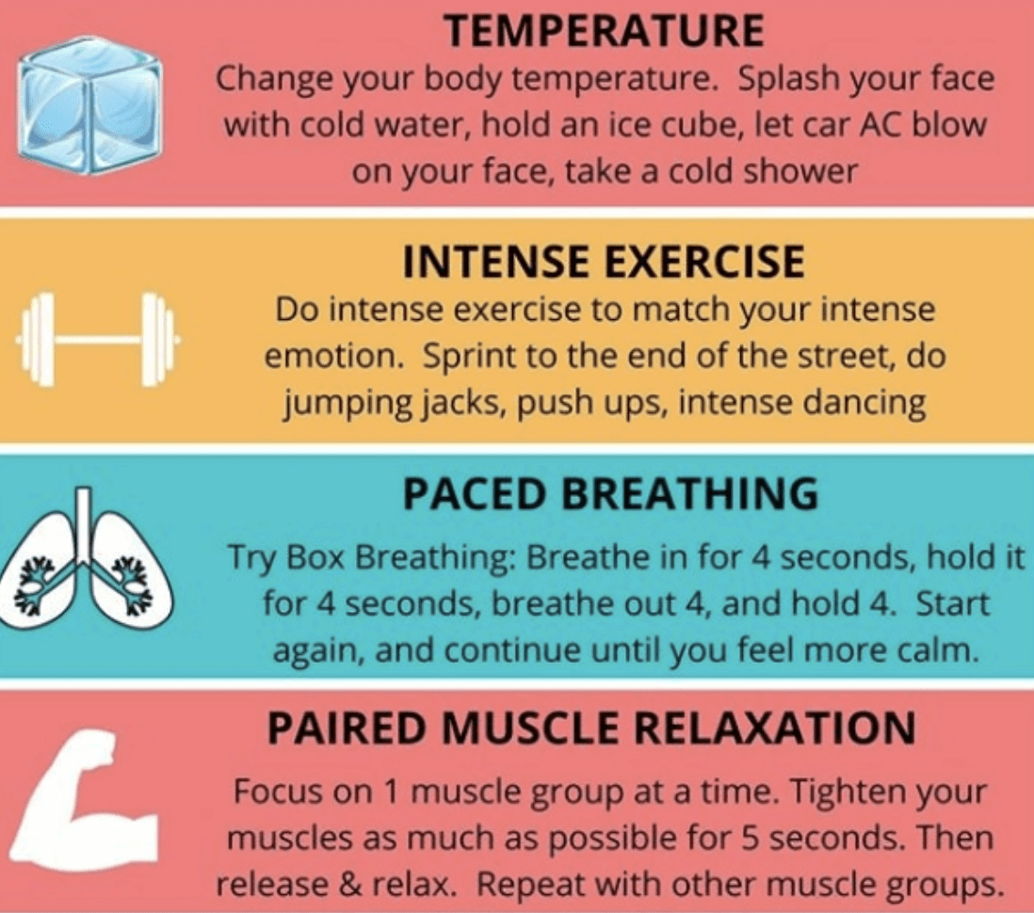
Responses to self harm – The TIPP Technique
The TIPP technique can be helpful in distracting very distressing feelings which may result in feeling the urge to self-harm.
You could try something like going out for a walk, listening to music, watching a show, speaking to someone or doing something else. The feelings may start to come down after a while.
Things which could help
Speak to your doctor
Talk to someone
Small mood boosters
Get outside
Create a care box
Make a safety plan for when things feel too overwhelming

Slide 30
What to do if more support is needed with risk or self harm?
In the chat, there is a document that provides information regarding services, apps, websites and organisations who can support. Please utilise this if needed.
Mental Health Support Team – Information and resources can be found on our website www.kirklees-keep-in-mind.nhs.uk
Kooth – Online, anonymous counselling for 10-25 year olds.
Night Owls – Confidential support via phone for cyp and parents, email or text 8pm – 8am.
The Brunswick Centre – For students wanting support around their gender and sexual identity.
The Base – Support for young people for drug and alcohol use.
A&E – To only be advised if severe risk to harm and parent/carer cannot
keep young person safe or if self-harm needs immediate medical intervention.

Slide 31
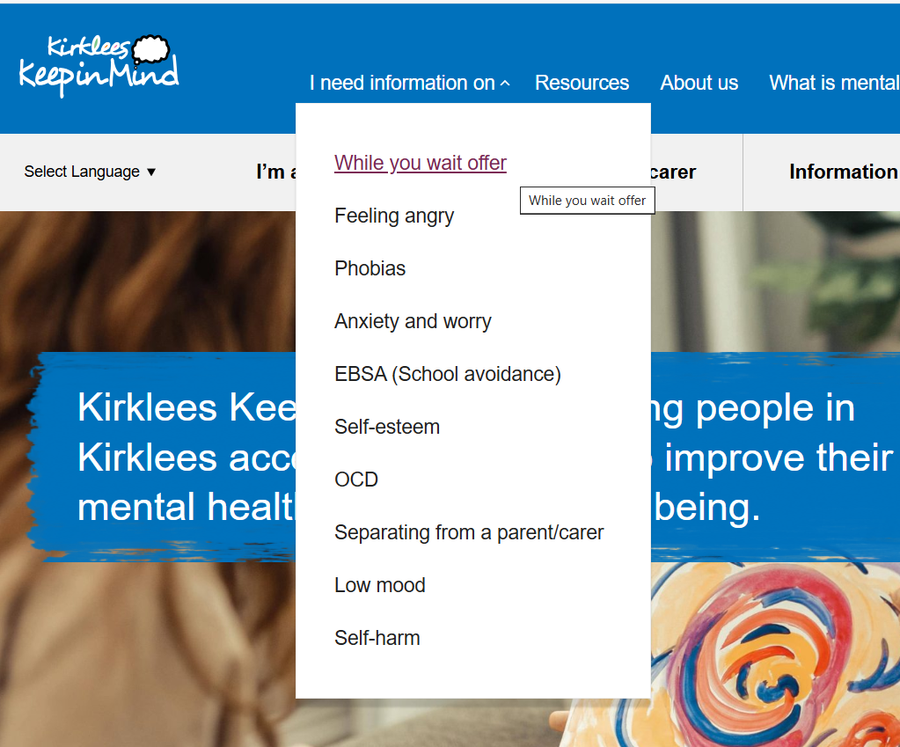
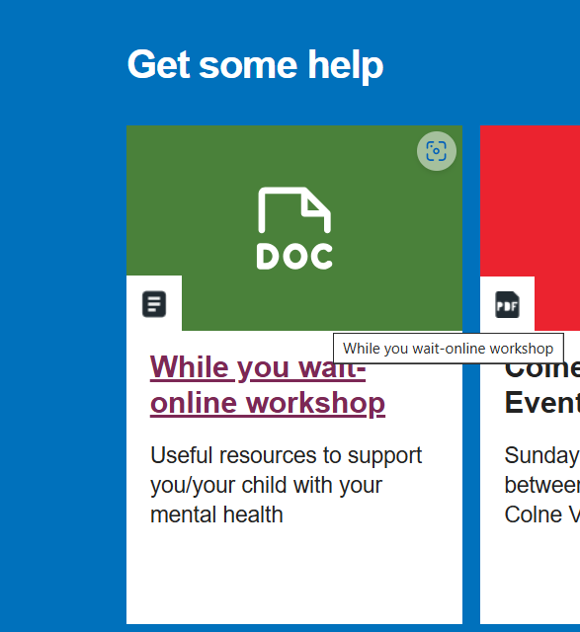
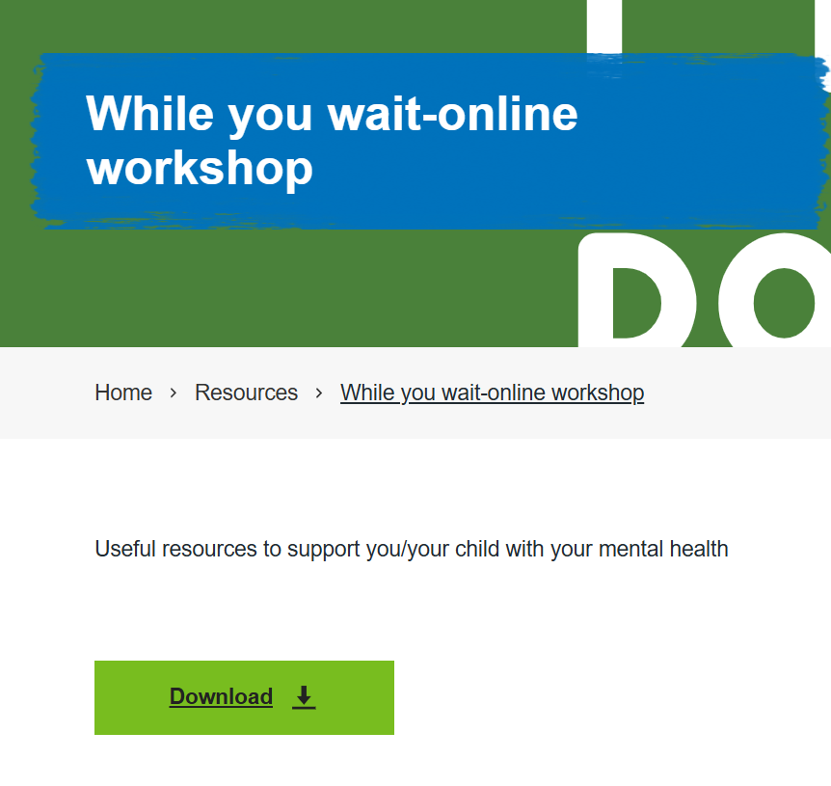
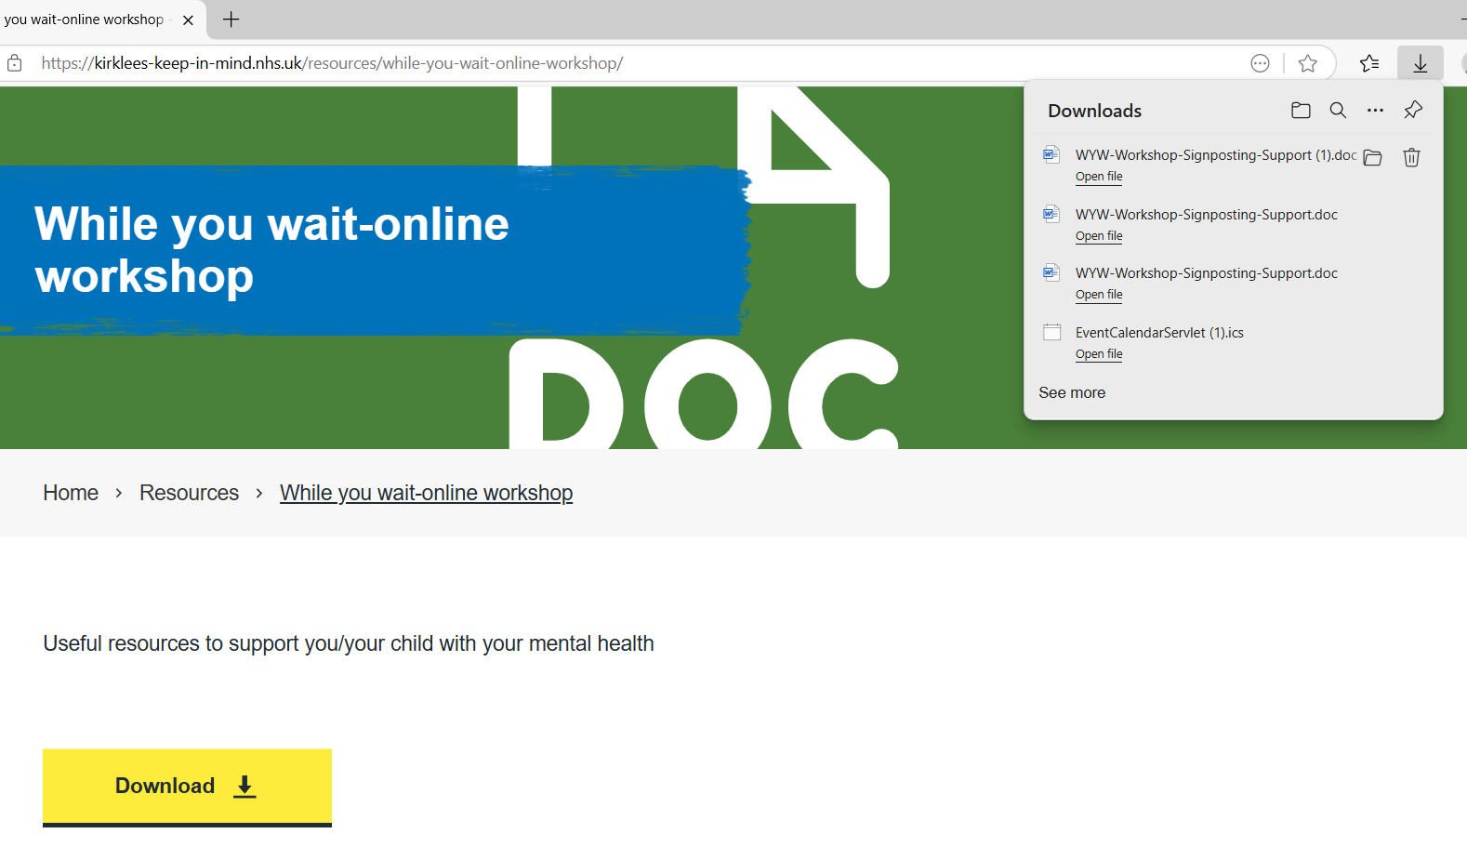
Supporting Information
Finding the document on our website.
www.kirklees-keep-in-mind.nhs.uk

Slide 32




Decision Making and Planning for the Future
We don’t have a crystal ball and often we don’t know what the outcome will be – this can be scary, especially in adolescence, but this is normal, and it can also be a time of excitement. Help your child to use skills to manage their emotions during these times and it will help them to make better decisions.
As your child progresses through adolescence, they are in a period of transformation to learn who they are and what they want and need. You can support them by helping them to use skills to help them understand their emotions and feelings.
It’s ok for adolescents to want to do things differently or go in a different direction to their peers, that is all part of growing up. Help them use skills to calm their nervous system so they can make the choices which are right for them.
Notes:
We don’t have a crystall ball so often we don’t know what the outcome will be and this can be scary
OK to take your own path – Period of transformation, lots of thoughts and ideas, gears are turning

Slide 33
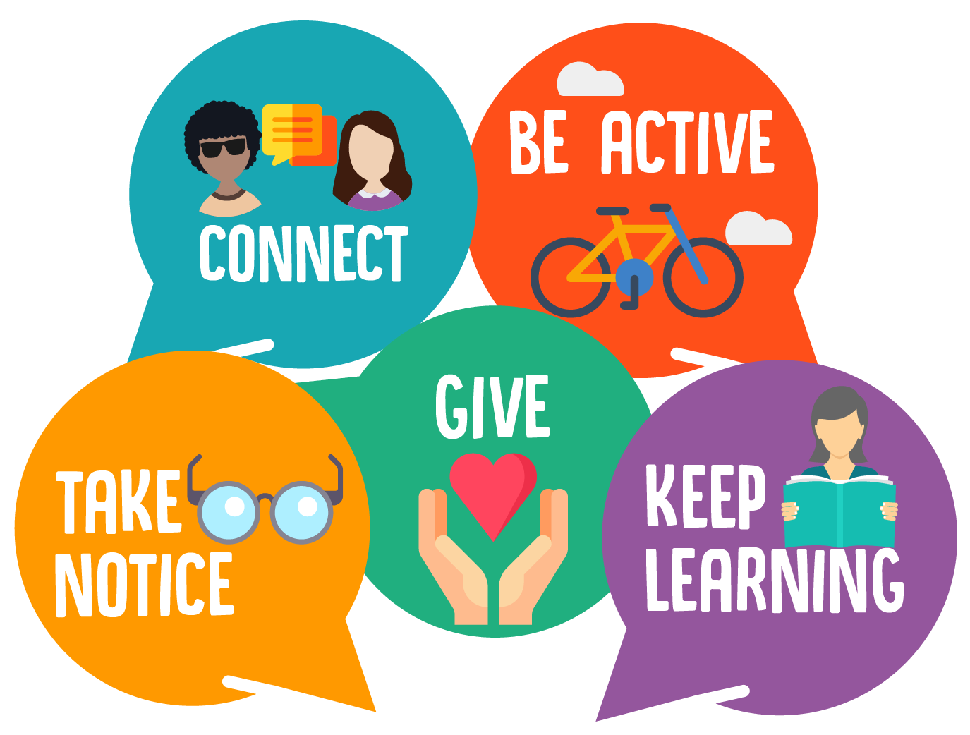
The NHS 5 Ways to Wellbeing
Notes:
If you practice the 5 ways to wellbeing when you’re feeling good, you will have the tools you need to support you when you’re not.

Slide 34
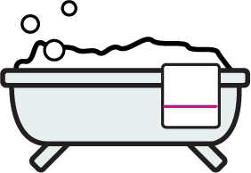


How to boost your child’s self-esteem/self confidence and bouncebackability
Look after yourself
Get enough sleep
Practice good sleep hygiene
Eat a balanced diet
Self-care
Do exercise
Be Kind to yourself
Celebrate your successes
Accept compliments
Challenge unkind thoughts about yourself
Limit social media use
Say positive things to yourself
Build Support Networks
Peer support groups
Avoid comparing yourself to others
Join a local club
Re-connect with old friends
Spend time with friends

Slide 35


Home Tasks
Reflections and things you can be doing while you wait for your assessment
Support your child to use coping skills to help manage their emotions
What do you do to manage your own stress? How do you relax?
  Create a self care plan for yourself.
How can you promote your child doing the same?
  Create a self care plan for your child.
How do you communicate with your child – what works what doesn’t? What works best for them?
What is in your control? What changes can you implement?

Slide 36
YouTube Resources
Fight Flight Freeze - A Guide to Anxiety for Kids
https://youtu.be/FfSbWc3O_5M?si=OcKK6ZA-cy1qQ3Wz
Fight Flight Freeze – Anxiety Explained For Teens
https://www.youtube.com/watch?v=rpolpKTWrp4
Unlocking the Adolescent Mind: Insights from Dr. Siegel
https://www.youtube.com/watch?v=0O1u5OEc5eY

Slide 37
Thank you!
Feedback
We would greatly appreciate your feedback via this short questionnaire.
https://www.surveymonkey.com/r/CPM5BNV

